Slide 1
Three papers in three and a third minutes each.
- By: José L. Pabón, N.J.I.T. Mathematical Sciences.
Advisors: Prof. Oza, Prof. Siegel.

Slide 2
Abstract – Research Plan.
Oza, Ristroph, Shelly model for hydrodynamic swimmers.
Matches experimental data well.
But does not consider 3D.
Also does not consider flow generated by neighbor swimmers.
Keller et al slender body potential flow results.
Gives us formulas for the flow generated by neighbor swimmers.
Scaffolding to determine 3D interactions.
Proposal project.
Increased
precision
hydro-
dynamic
3D
model.

Slide 3
Agenda
Brief discussion of the following papers:
‘Lattices of Hydrodynamically Interacting Flapping Swimmers’ by Oza, Ristroph, Shelley.
‘Axially symmetric potential flow around a slender body’ by Handelsman and Keller.
‘Uniform Asymptotic Solutions for Potential Flow around a thin airfoil and the Electrostatic Potential about a thin conductor’ by Geer and Keller.

Slide 4
Thanks!
Prof. Oza, Prof. Siegel.

Slide 5
Thanks!
Prof. Oza, Prof. Siegel.
Prof. Michalopoulou, Prof. Luke, Prof. Matveev, Prof. Muratov, Prof. Blackmore, Prof. Hamfeldt, Prof. Askham, Prof. Lushi, Prof. Milojevic, Prof. Petropoulous.

Slide 6
Thanks!
Prof. Oza, Prof. Siegel.
Prof. Michalopoulou, Prof. Luke, Prof. Matveev, Prof. Muratov, Prof. Blackmore, Prof. Hamfeldt, Prof. Askham, Prof. Lushi, Prof. Milojevic, Prof. Petropoulous.
Ryan (s), Rituparna, Axel, Erli, Yasser, Yichen, Connor, Lauren, Soheil, Brandon, Subhrasish, Malik, Binan, Guangyuan, Nick, Austin, Moshe, Jake, Sam, Atul, Fataou, Chyavi, Milad, Prianka, John, et al.

Slide 7
Thanks!
Prof. Oza, Prof. Siegel.
Prof. Michalopoulou, Prof. Luke, Prof. Matveev, Prof. Muratov, Prof. Blackmore, Prof. Hamfeldt, Prof. Askham, Prof. Lushi, Prof. Milojevic, Prof. Petropoulous.
Ryan (s), Rituparna, Axel, Erli, Yasser, Yichen, Connor, Lauren, Soheil, Brandon, Subhrasish, Malik, Binan, Guangyuan, Nick, Austin, Moshe, Jake, Sam, Atul, Fataou, Chyavi, Milad, Prianka, John, et al.
My family… especially my sister Maria!

Slide 8
Goal:
Share some of my research literature review findings.

Slide 9
Goal:
Share some of my research literature review findings.
Give a glimpse of the direction of my future research.

Slide 10
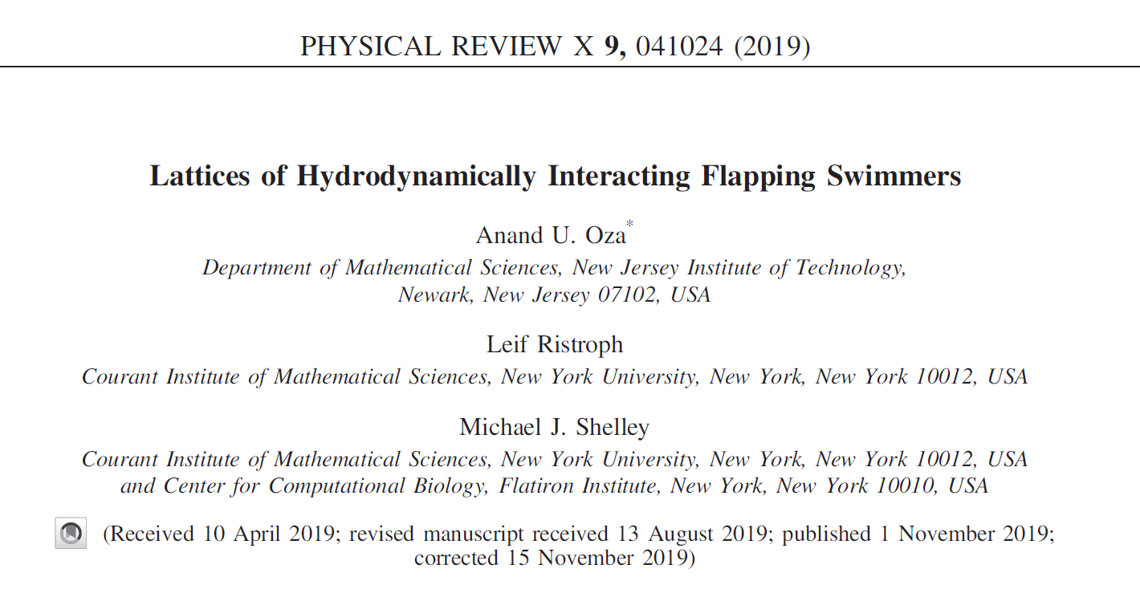
Oza et al, Hydrodynamic swimmers

Slide 11
Oza et al, Hydrodynamic swimmers.
All media and videos are credited to source material from Ananda Oza and Sophie Ramananarivo and the Applied Mathematics Laboratory of the Courant Institute of Mathematical sciences.

Slide 12
Oza et al, Hydrodynamic swimmers
The work centers around the complex collective dynamics of schools of fish and flocks of birds and the influence of hydrodynamics on the self organization of these.

Slide 13
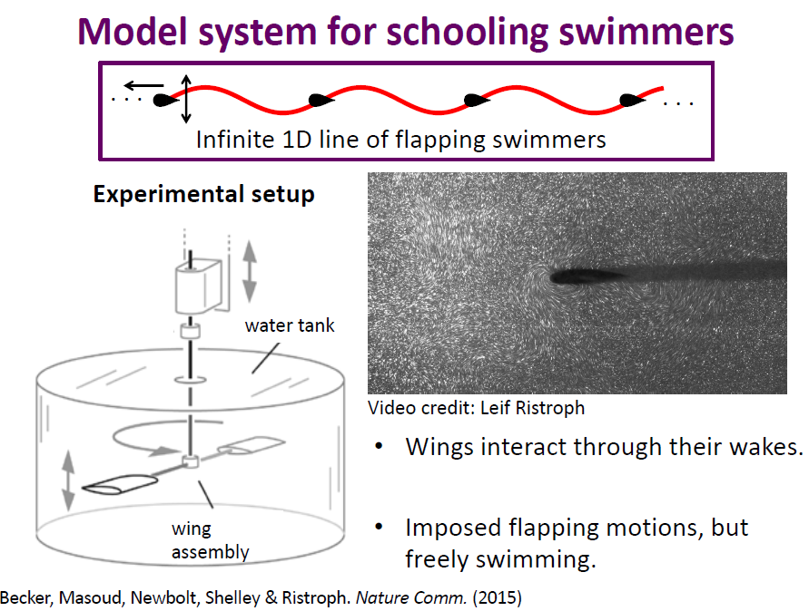
Oza et al, Hydrodynamic swimmers.

Slide 14
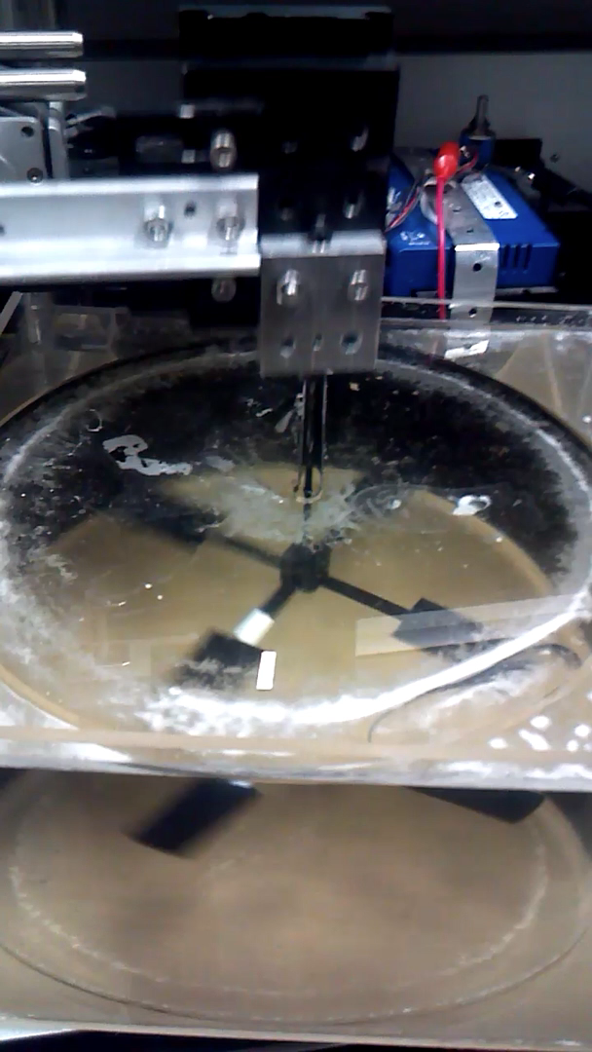
Oza et al, Hydrodynamic swimmers.

Slide 15
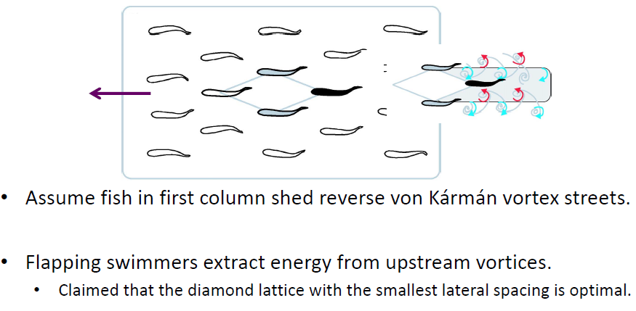
Oza et al, Hydrodynamic swimmers.

Slide 16
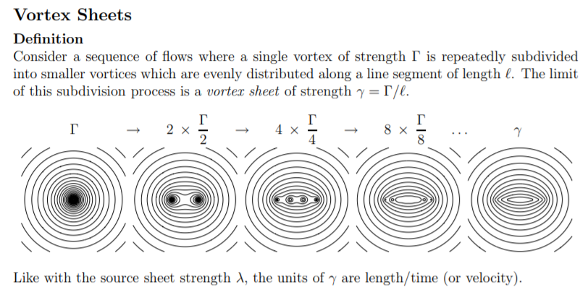
Oza et al, Hydrodynamic swimmers.
Credit – MIT Unified Engineering Fluids 16.003 Lecture Notes f18.

Slide 17
Oza et al, Hydrodynamic swimmers.
Clarifications / definitions:

Slide 18
Oza et al, Hydrodynamic swimmers.
Clarifications / definitions:
Vortex shedding is an oscillating flow that fluid generates when it flows past a bluff body at certain velocities, depending on the size and shape of the body. On a streamlined body, as opposed to bluff body, the flow would be different.

Slide 19
Oza et al, Hydrodynamic swimmers.
Clarifications / definitions:
Vortex shedding is an oscillating flow that fluid generates when it flows past a bluff body at certain velocities, depending on the size and shape of the body. On a streamlined body, as opposed to bluff body, the flow would be different.
A Karman vortex street is the repeating pattern of swirling vortices created by the process of vortex shedding.

Slide 20
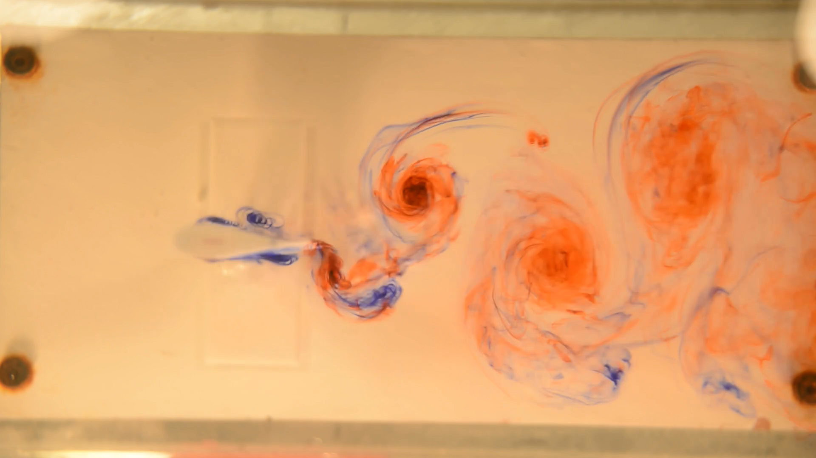
Oza et al, Hydrodynamic swimmers.

Slide 21
Oza et al, Hydrodynamic swimmers
The work centers around the complex collective dynamics of schools of fish and flocks of birds and the influence of hydrodynamics on the self organization of these.
An iterated map is formulated to describe the hydrodynamic interactions between the vortices and the downstream swimmers.

Slide 22
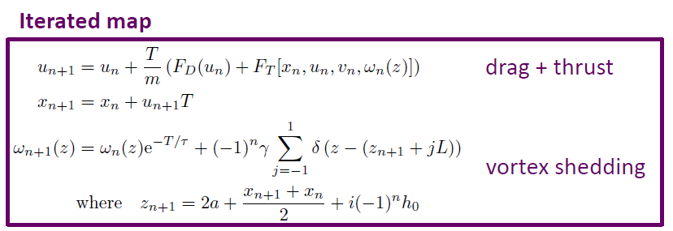
Oza et al, Hydrodynamic swimmers.

Slide 23
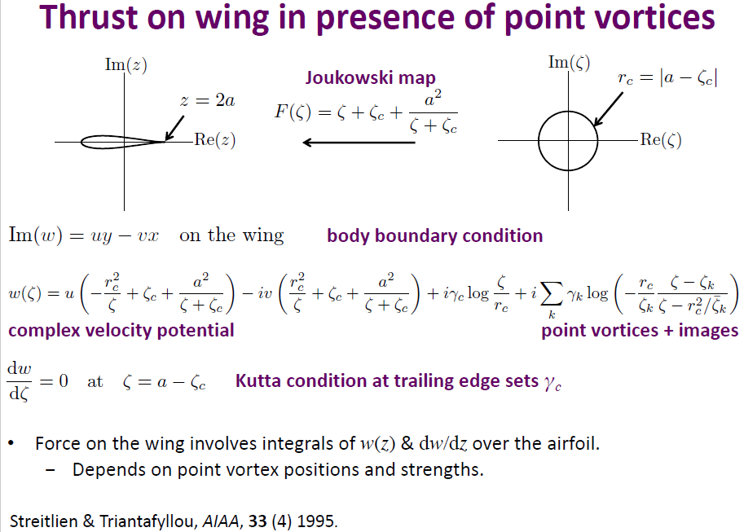
Oza et al, Hydrodynamic swimmers.

Slide 24
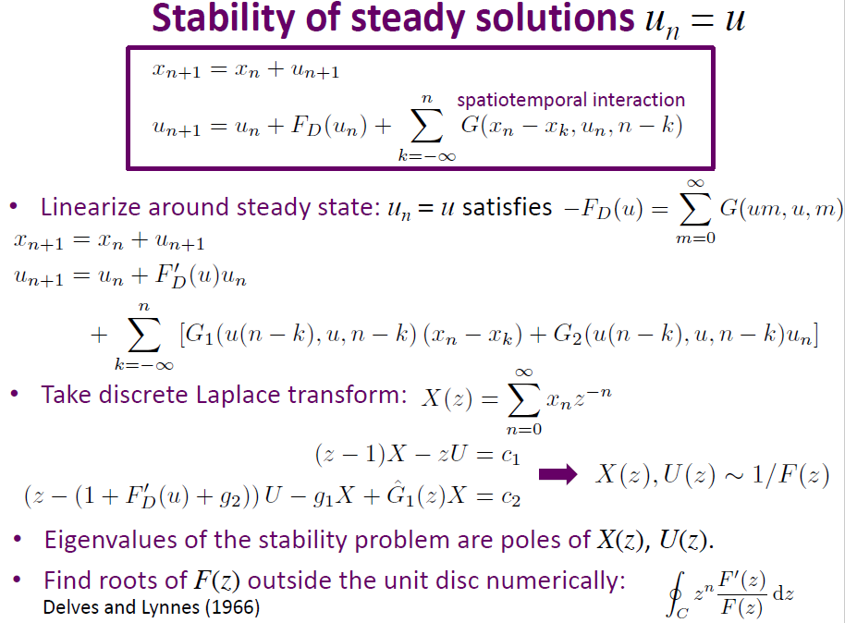
Oza et al, Hydrodynamic swimmers.

Slide 25
Oza et al, Hydrodynamic swimmers
The work centers around the complex collective dynamics of schools of fish and flocks of birds and the influence of hydrodynamics on the self organization of these.
An iterated map is formulated to describe the hydrodynamic interactions between the vortices and the downstream swimmers.
Thanks to the kind folks at C.I.M.S., we have experimental results.

Slide 26
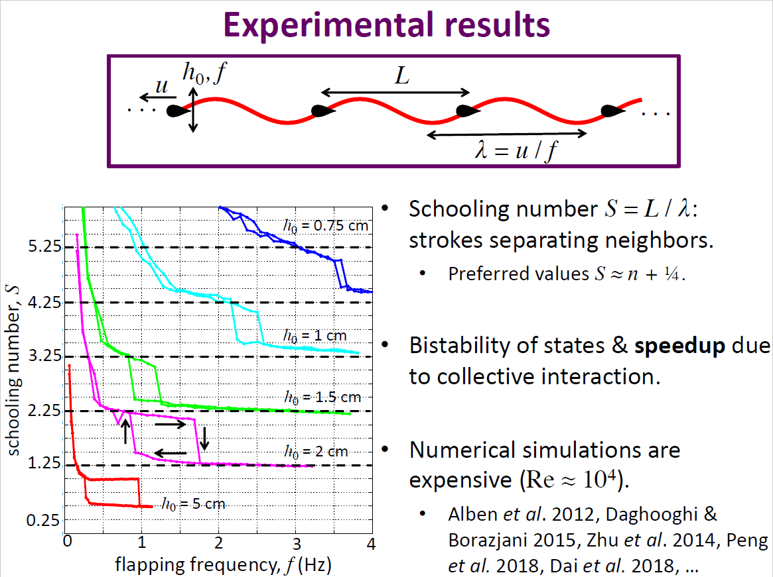
Oza et al, Hydrodynamic swimmers.

Slide 27
Oza et al, Hydrodynamic swimmers
The work centers around the complex collective dynamics of schools of fish and flocks of birds and the influence of hydrodynamics on the self organization of these.
An iterated map is formulated to describe the hydrodynamic interactions between the vortices and the downstream swimmers.
Thanks to the kind folks at C.I.M.S., we have experimental results.
The results exhibit good agreement with previously published experimental data.

Slide 28
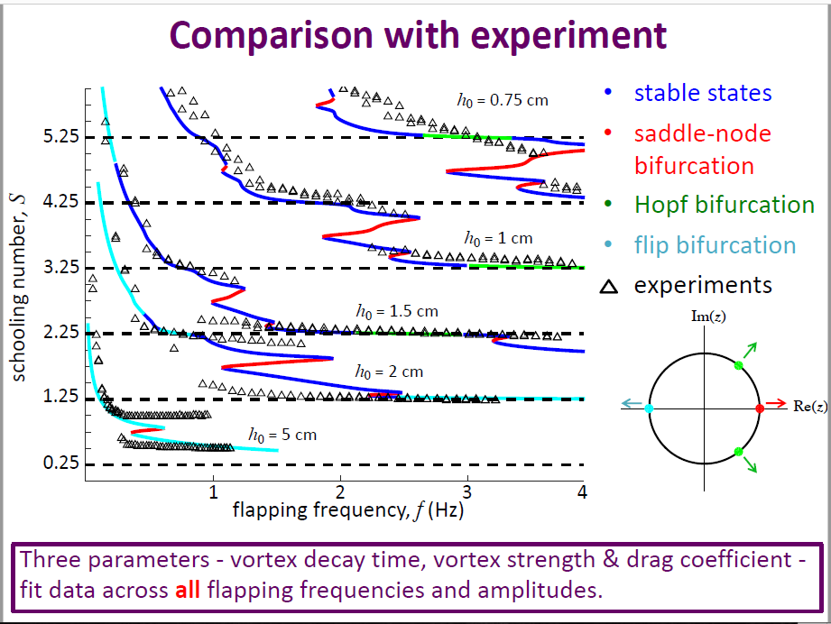
Oza et al, Hydrodynamic swimmers.

Slide 29
Oza et al, Hydrodynamic swimmers.
The work presents outstanding results.

Slide 30
Oza et al, Hydrodynamic swimmers.
The work presents outstanding results.
Open questions remain…

Slide 31
Oza et al, Hydrodynamic swimmers.
The work presents outstanding results.
Open questions remain…
One open problem question – what are the hydrodynamics when the flow generated by neighbors is considered?

Slide 32
Oza et al, Hydrodynamic swimmers.
The work presents outstanding results.
Open questions remain…
One open problem question is – what are the hydrodynamics of the swimmers situation when the flow generated by neighbors is considered?

Slide 33
Joseph Keller – Professor Emeritus.
David Hilbert University of Königsberg
George Papanicolaou NYU
Russel Caflisch NYU
Richard Courant NYU
Michael Siegel NYU / NJIT
Joseph Keller NYU

Slide 34
Joseph Keller – Professor Emeritus.
David Hilbert University of Königsberg
George Papanicolaou NYU
Russel Caflisch NYU
Richard Courant NYU
Michael Siegel NYU / NJIT
Joseph Keller NYU
José Pabón NYU / NJIT

Slide 35
Joseph Keller – Professor Emeritus.
David Hilbert University of Königsberg
George Papanicolaou NYU
Russel Caflisch NYU
Richard Courant NYU / Stanford
Michael Siegel NYU / NJIT
José Pabón NJIT

Slide 36
Joseph Keller

Slide 37
Keller et al, Slender body potential flow.
The potential due to the body is represented as a superposition of potentials of point sources distributed along a segment of the axis inside the body.

Slide 38
Keller et al, Slender body potential flow.
The potential due to the body is represented as a superposition of potentials of point sources distributed along a segment of the axis inside the body.

Slide 39
Keller et al, Slender body potential flow.

Slide 40
Keller et al, Slender body potential flow.
The potential due to the body is represented as a superposition of potentials of point sources distributed along a segment of the axis inside the body.
The source strength distribution satisfies a linear integral equation.

Slide 41
Keller et al, Slender body potential flow.
The potential due to the body is represented as a superposition of potentials of point sources distributed along a segment of the axis inside the body.
The source strength distribution satisfies a linear integral equation.
A uniform asymptotic expansion of its solutions is obtained with respect to the slenderness ratio: the maximum radius of the body divided by its length.

Slide 42
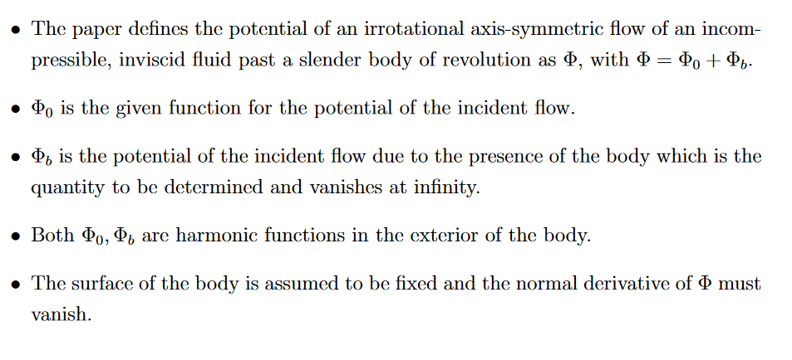
Keller et al, Slender body potential flow.
The potential due to the body is represented as a superposition of potentials of point sources distributed along a segment of the axis inside the body.

Slide 43
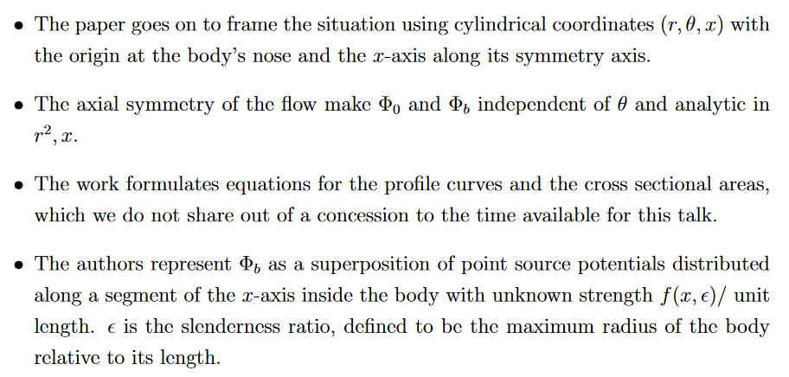
Keller et al, Slender body potential flow.

Slide 44
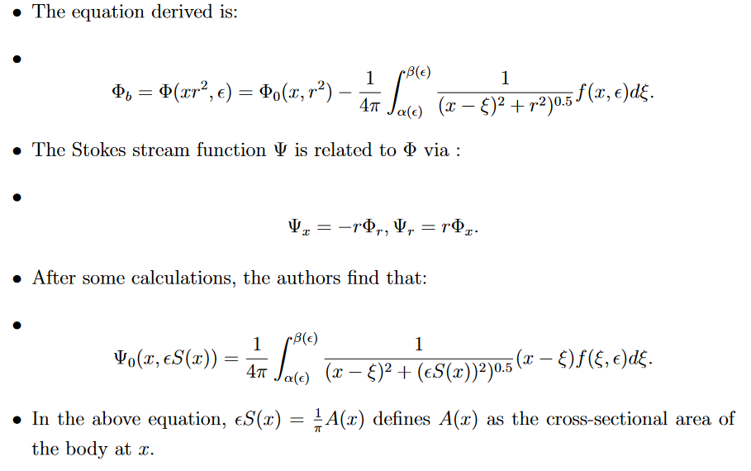
Keller et al, Slender body potential flow.

Slide 45
Keller et al, Slender body potential flow.
The potential due to the body is represented as a superposition of potentials of point sources distributed along a segment of the axis inside the body.
The source strength distribution satisfies a linear integral equation.
A uniform asymptotic expansion of its solutions is obtained with respect to the slenderness ratio: the maximum radius of the body divided by its length.
Results include: expansions of the potential, the virtual mass and the dipole moment are obtained, as well as the flow about the body.

Slide 46
Keller et al, Slender body potential flow.
The potential due to the body is represented as a superposition of potentials of point sources distributed along a segment of the axis inside the body.
The source strength distribution satisfies a linear integral equation.
A uniform asymptotic expansion of its solutions is obtained with respect to the slenderness ratio: the maximum radius of the body divided by its length.
Results included: expansions of the potential, the virtual mass and the dipole moment are obtained, as well as the flow about the body.
The method of analysis involved a technique for the asymptotic solution of integral equations.

Slide 47
Keller et al, Slender body potential flow.
Much more information to be found in the literature… moving on!

Slide 48
Keller et al, Uniform Asymptotic Solutions.
This work considers the two-dimensional irrotational flow of an incompressible inviscid fluid past a thin cylindrical airfoil and the two-dimensional field in the exterior of a thin cylindrical conductor.

Slide 49
Keller et al, Uniform Asymptotic Solutions.
This work considers the two-dimensional irrotational flow of an incompressible inviscid fluid past a thin cylindrical airfoil and the two-dimensional field in the exterior of a thin cylindrical conductor.
Uniform asymptotic expansions of these two potentials are obtained with respect to the slenderness ratio of the profile curve C of the cylinder.

Slide 50
Keller et al, Uniform Asymptotic Solutions.
This work considers the two-dimensional irrotational flow of an incompressible inviscid fluid past a thin cylindrical airfoil and the two-dimensional field in the exterior of a thin cylindrical conductor.
Uniform asymptotic expansions of these two potentials are obtained with respect to the slenderness ratio of the profile curve C of the cylinder.
A superposition of potentials of point sources distributed along a segment of the axis inside C are used to find the overall potential.

Slide 51
Keller et al, Uniform Asymptotic Solutions.
This work considers the two-dimensional irrotational flow of an incompressible inviscid fluid past a thin cylindrical airfoil and the two-dimensional field in the exterior of a thin cylindrical conductor.
Uniform asymptotic expansions of these two potentials are obtained with respect to the slenderness ratio of the profile curve C of the cylinder.
A superposition of potentials of point sources distributed along a segment of the axis inside C are used to find the overall potential.
The source strength distribution satisfies a linear integral equation.

Slide 52
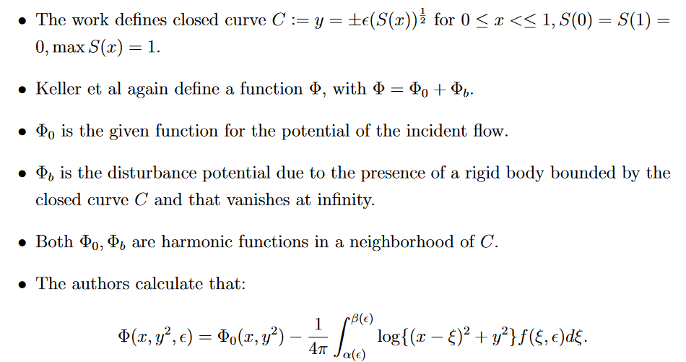
Keller et al, Uniform Asymptotic Solutions.

Slide 53
Keller et al, Uniform Asymptotic Solutions.
This work considers the two-dimensional irrotational flow of an incompressible inviscid fluid past a thin cylindrical airfoil and the two-dimensional field in the exterior of a thin cylindrical conductor.
Uniform asymptotic expansions of these two potentials are obtained with respect to the slenderness ratio of the profile curve C of the cylinder.
A superposition of potentials of point sources distributed along a segment of the axis inside C are used to find the overall potential.
The source strength distribution satisfies a linear integral equation.
Complete expansions of the virtual mass, the polarizability, and the lift of the cylinder are obtained as results.

Slide 54
Title and Content Layout with List
Add your first bullet point here
Add your second bullet point here
Add your third bullet point here

Slide 55
Title and Content Layout with List
Add your first bullet point here
Add your second bullet point here
Add your third bullet point here

Slide 56
Title and Content Layout with List
Add your first bullet point here
Add your second bullet point here
Add your third bullet point here

Slide 57
Title and Content Layout with List
Add your first bullet point here
Add your second bullet point here
Add your third bullet point here

Slide 58
Title and Content Layout with List
Add your first bullet point here
Add your second bullet point here
Add your third bullet point here

Slide 59
Title and Content Layout with Chart

Slide 60
Two Content Layout with Table
First bullet point here
Second bullet point here
Third bullet point here
Class | Group A | Group B
Class 1 | 82 | 95
Class 2 | 76 | 88
Class 3 | 84 | 90

Slide 61
Two Content Layout with SmartArt
Group A
Task 1
Task 2
Group B
Task 1
Task 2
Group C
Task 1
First bullet point here
Second bullet point here
Third bullet point here

Slide 62

Thanks for listening! Questions / comments are warmly welcome… the work in progress.

Slide 63
References:
Oza, Anand U., Leif Ristroph, and Michael J. Shelley. "Lattices of hydrodynamically interacting flapping swimmers." Physical Review X 9.4 (2019): 041024.
Handelsman, Richard A., and Joseph B. Keller. "Axially symmetric potential flow around a slender body." Journal of Fluid Mechanics 28.1 (1967): 131-147.
Geer, James F., and Joseph B. Keller. "Uniform asymptotic solutions for potential flow around a thin airfoil and the electrostatic potential about a thin conductor." SIAM Journal on Applied Mathematics 16.1 (1968): 75-101.
Krasny, R., “Vortex Sheet Roll-Up due to the motion of a flat plate.”, for the Mathematics Department of the University of Michigan, Ann Arbor, MI.
Siegel, M. and Booty, M.R., “Steady deformation and tip-streaming of a slender bubble with surfactant in en extensional flow” for the Department of Mathematical Sciences at New Jersey Institute of Technology, Newark, NJ., CAMS Report 0506-20, Spring 2006.

Slide 64
Add a Slide Title - 3

Slide 66
Add a Slide Title - 4

Slide 67
Add a Slide Title - 5

